Slide 1


Boston Home Pricing Prediction
By:
Kurt Grothe
Kamika Hughes
Daniel Lagos

Slide 2
Let’s talk variables
Crime: per capita crime rate by town
Zone: proportion of residential land zoned for lots over 25,000 sq.ft.
Indus: proportion of non-retail business acres per town
River: Charles River dummy variable (=1 if tract bounds river; 0 otherwise)
Nox: nitric oxides concentration (parts per 10 million)
Room_num: average number of rooms per dwelling
Owner: proportion of owner-occupied units built prior to 1940
Distance: weighted distances to five Boston employment centers
Highway: index of accessibility to radial highways
Tax: full-value property-tax rate per $10,000
Teacher: pupil-teacher ratio by town
Lstat % lower status of the population
Medv: Median value of owner-occupied homes in $1000’s

Slide 3
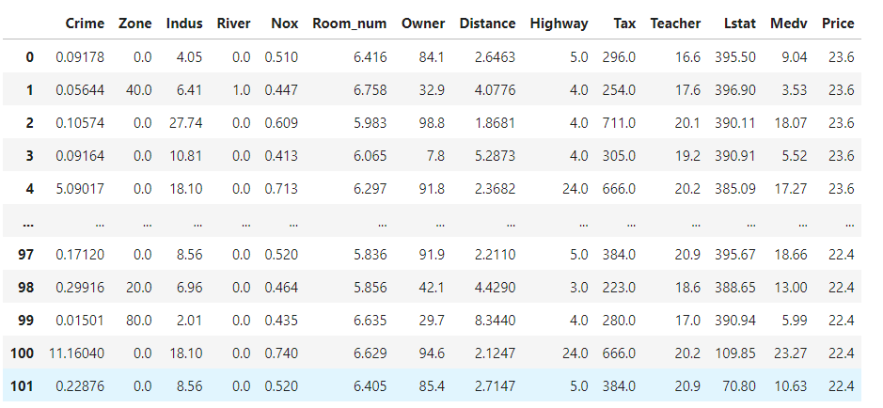
Head and tail of data

Slide 4
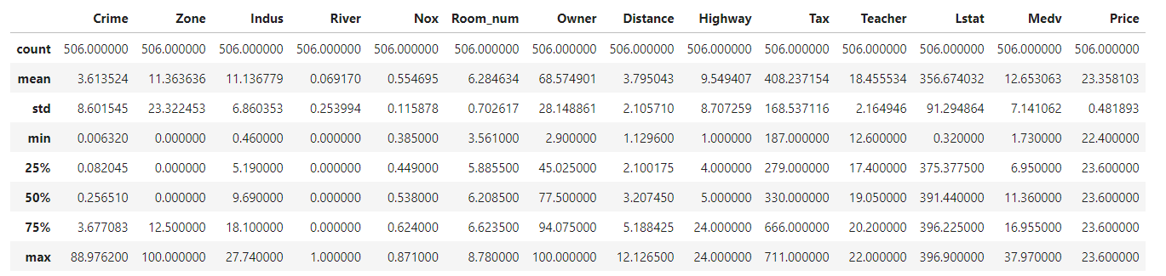
Summary statistics

Slide 5
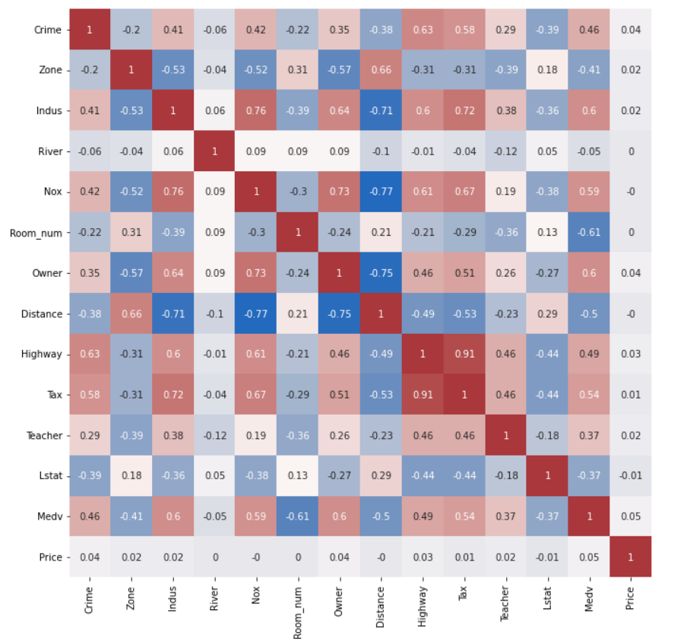
Correlation Matrix

Slide 6
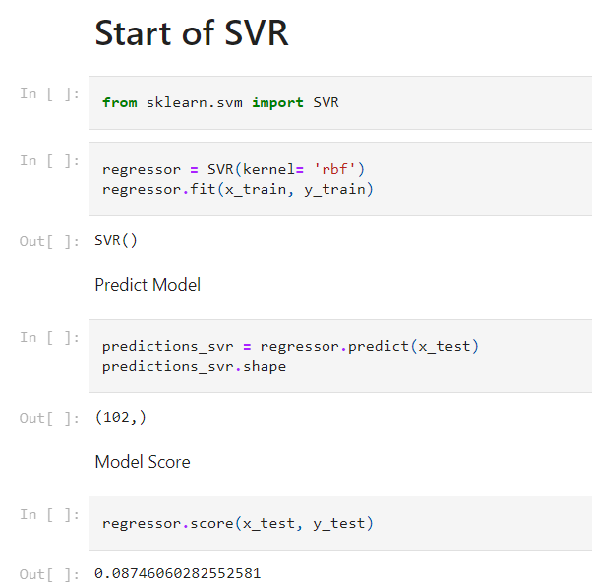
Supervised Machine learning algorithm
Support Vector Regression Model was chosen to help predict housing costs in Boston. This is how we went about training the algorithm:
Notes:
As you notice the original prediction and model score was less than anticipated so we made some adjustments to help increase the algorithm’s score

Slide 7
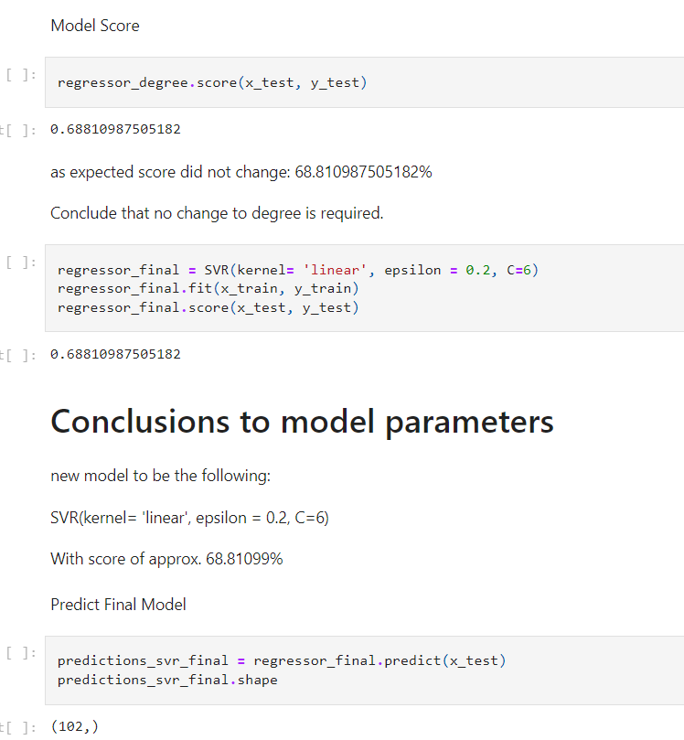
Support Vector Regression Continued
After tuning the kernel, Epsilon, C, and Degree the model score increased by over 60%

Slide 8
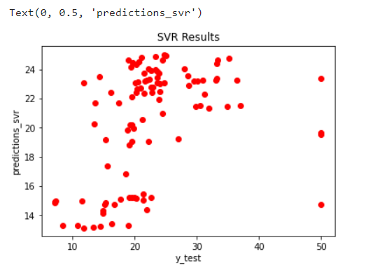
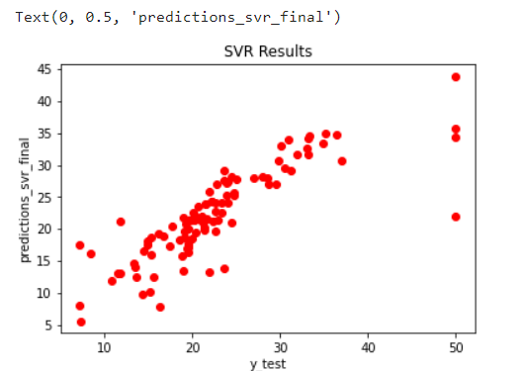
Visual comparison of model
Before tuning
After tuning

Slide 9
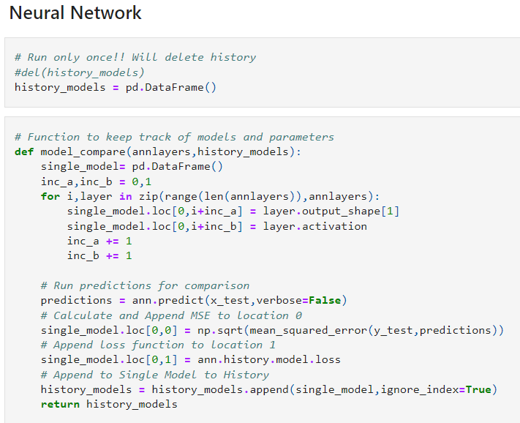
Neural network algorithm info

Slide 10
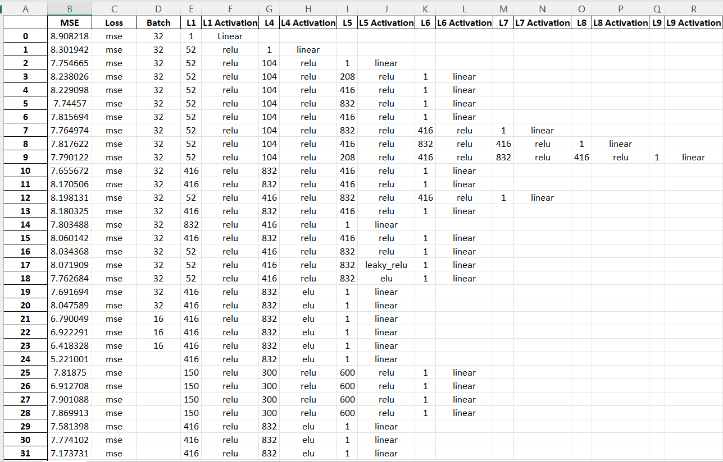
NN Tuning

Slide 11
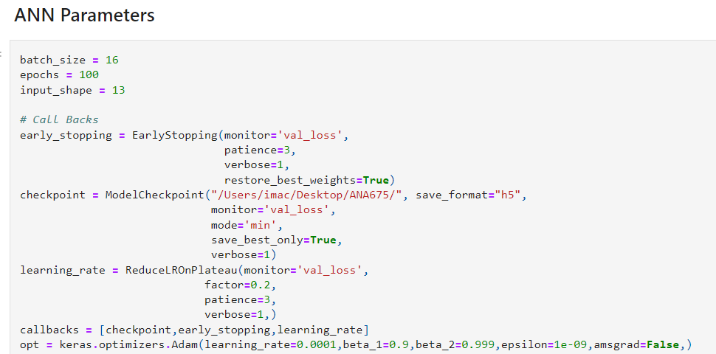
Neural network algorithm info continued

Slide 12
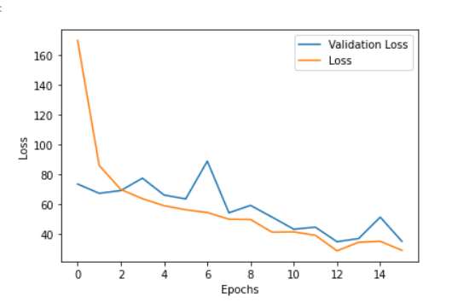
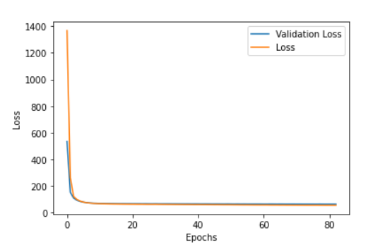
Nn loss comparision
Before tuning
After tuning

Slide 13
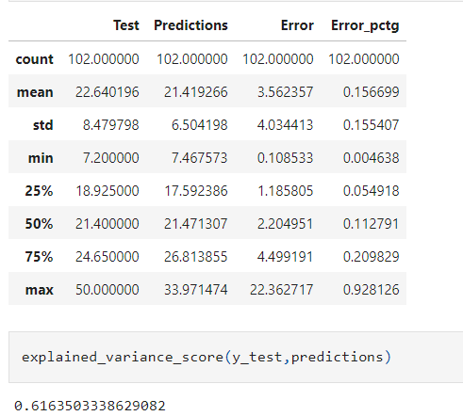
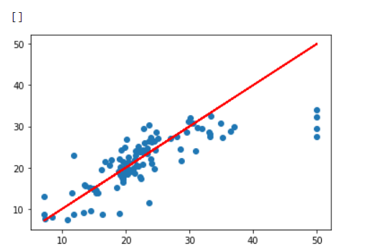
Neural network predictions

Slide 14

Prediction Comparison breakdown

Slide 15
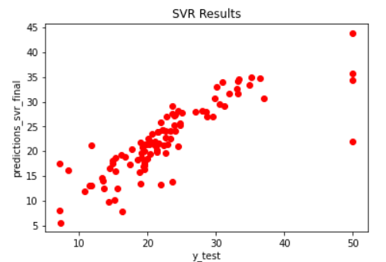

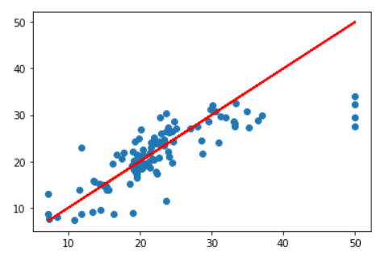

Comparison of models
Neural Network
Supervised Machine Learning

Slide 16
Which is better
Although the visual comparison was close in the previous slide, the Neural Network algorithm is the better algorithm between the two tested in the assignment.

Slide 17
Final overview
The SVR had an above average prediction percentage at just over 68% which is better than the original run of the algorithm
The Neural Network algorithm’s prediction average prediction error percentage of just over 16% this shows surprising accuracy when compared to the SVR.
The mean squared error of the neural network is 5.38 which is higher than the ideal value of 0, but it is very low showing predictions are close to the actual values.

Slide 18
Thank you

